Slide 1
Topic 3 bonding

Slide 2
Metallic Bonding

Slide 3
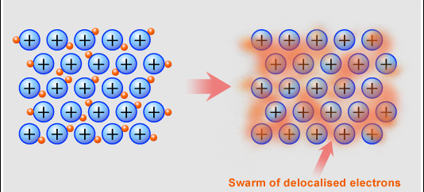
Metallic bonding
Occurs b/w atoms which all have low electronegativities.
Metallic structure is often described as consisting of a lattice of positive ions filled by a mobile “sea” of valence electrons.
Outermost electrons wander freely through metal. Metal consists of cations held together by negatively-charged electron "glue."

Slide 4
Strength of metallic bonding
How many electrons each atom shares with the others.
K 2,8,8,1 b.p. 337K
Ca 2,8,8,2 1123K
Sc 2,8,8,3 1703K
How far from the positive nucleus the electrons in the “sea” are (Ionic radius)
Li 2,1 b.p. 454K
Na 2,8,1 371K
K 2,8,8,1 337K
How big the metal cation is？

Slide 5
Properties of metals
Melting point
Na has one delocalized electron per atom and the Na+ ion, whereas Mg will have two delocalized electrons per atom and the Mg2+ ion. In addition
The radius of Mg2+ is slightly smaller than that of Na+.
These factors all indicate that Mg has stronger metallic bonding than Na, which can be confirmed by a comparison of their melting points.

Slide 6
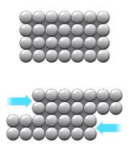

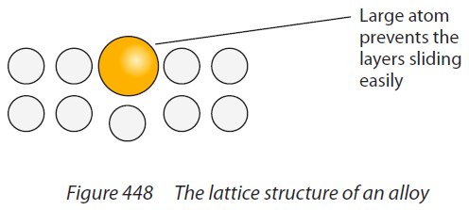
Properties of metals
Unlike the brittleness in ionic compound
Malleability and ductility
The layers of atoms in metal are hard to pull apart because of the electrons holding them together, hence metals are tough. But individual atoms are not held to any other specific atoms, hence atoms slip easily past one another. Thus metals are malleable and ductile.

Slide 7
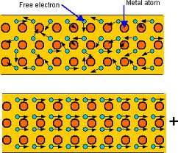
Properties of metals
Electrical conductivity
Free electrons can move rapidly in response to electric fields, hence metals are a good conductor of electricity.

Slide 8
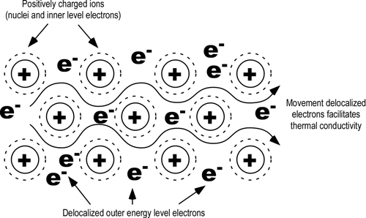
Properties of metals
Good conductor of heat
Free electrons can transmit kinetic energy rapidly, hence metals are good conductors of heat

Slide 9
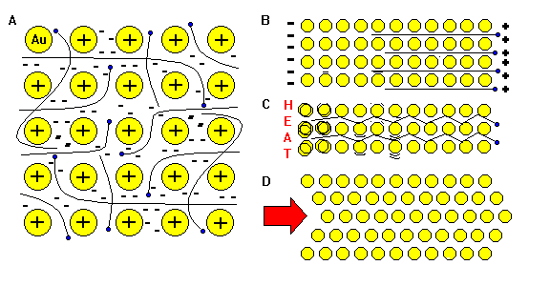
Properties of metal
A. Outermost electrons wander freely through metal. Metal consists of cations held together by negatively-charged electron "glue."
B. Free electrons can move rapidly in response to electric fields, hence metals are a good conductor of electricity.
C. Free electrons can transmit kinetic energy rapidly, hence metals are good conductors of heat.
D. The layers of atoms in metal are hard to pull apart because of the electrons holding them together, hence metals are tough. But individual atoms are not held to any other specific atoms, hence atoms slip easily past one another. Thus metals are malleable and ductile. Metallic Bonding is the basis of our industrial civilization.

Slide 10
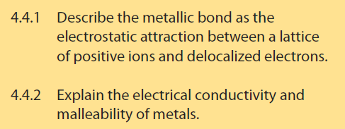
Assessment Statement

Slide 11
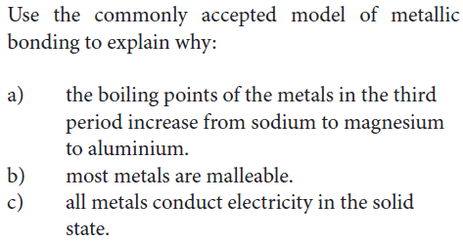
Practice

